Slide 1
The Player Base on Steam
Larry Agyei & Dennis Lupin

Slide 2
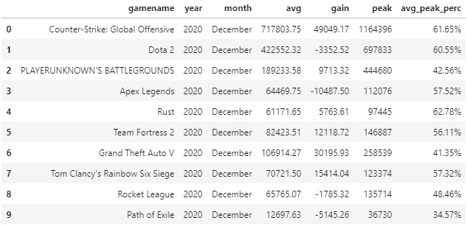
Introduction to the Topic
We looked at a data set based on the average number of players of every game on Steam for every month from 2012 to 2021. However, the since the years 2012 and 2021 weren’t full years and only contained a few of the months, we decided to remove those years as it did not affect our results.

Slide 3
Background Information
Steam is marketplace for games on the computer, similar to the way it works on xbox and playstation. Steam’s player base is worldwide and has millions of players daily.
After reviewing the data, we hypothesize that as the years went on, the number of players increased.

Slide 4
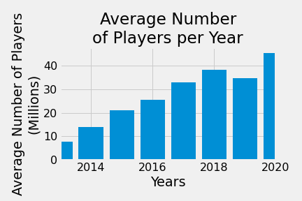
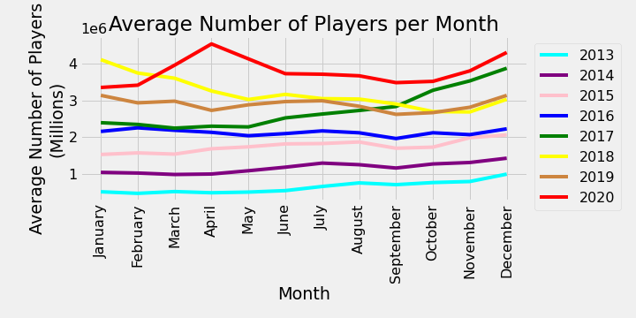
To try and prove our hypothesis, we made these graphs. It show the average number of players each year. As you can see, there is an obvious steady increase in the number of players each year.

Slide 5
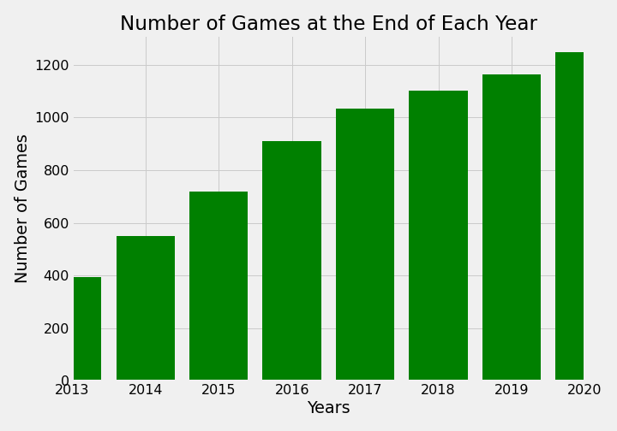
In an attempt to understand the reason behind the increase of players, we made this graph. After calculating the correlation coefficient, both graphs came out to be 0.98. A near perfect positive linear relationship.

Slide 6
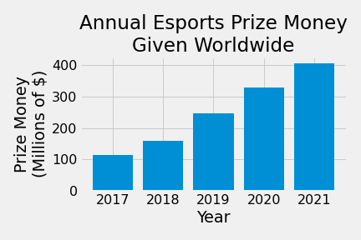
Another possible reason for the increase in players had to do with Esports. After finding some data we were able to make this graph showing the total amount of money set as prize money for winning esports tournaments. Just like the previous two graphs, there is a steady gain each year.

Slide 7
After looking at those graphs, we felt as though we proved our hypothesis correct. However, after looking at the average number of player by month each year, we saw something interesting.

Slide 8
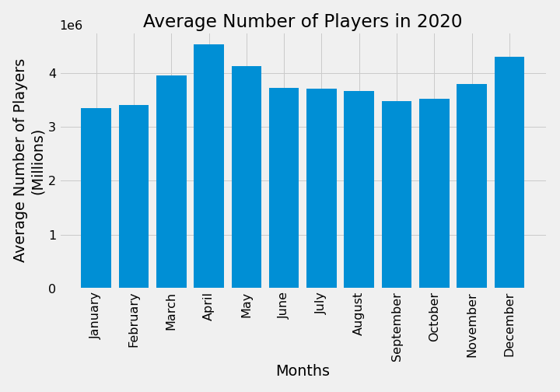
The year 2020 had a spike of players in the beginning of the year. As COVID was starting to be recognized worldwide and isolations started to take effect, people most likely turned to video games to pass the time. Which would explain the spike. The decrease of the spike is most likely due to the warm weather as people left their house to do outdoor activities.

Slide 9
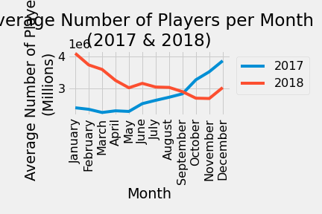
Another thing we found interesting was that there as an increase of players as 2017 ended, but then a large decline in players in 2018. This may be due to the popularity of battle royale games like Fortnite and PlayerUnknown’s Battlegrounds.

Slide 10

Challenges
The most challenging part of our analysis was thinking of potential variables as to why our numbers were the way they are. There were many smaller stories being told over the course of the time period the data was taken from, so we had to brainstorm reasonable variables and find out if said variables had a strong correlation with the data of the original data set.

Slide 11
Useful Datasets
If we were able to get any possible data set it would be yearly download/ buy rates for online video games. This data set would go hand in hand with our data set for the number of Steam players since we would be able to see if these rates either increased or decreased over time, and whether or not the correlation between time and the download/buy rates would be similar to the correlation coefficient of the amount of Steam players per year.

Slide 12
Thank You!
Any Questions?

